Slide 1

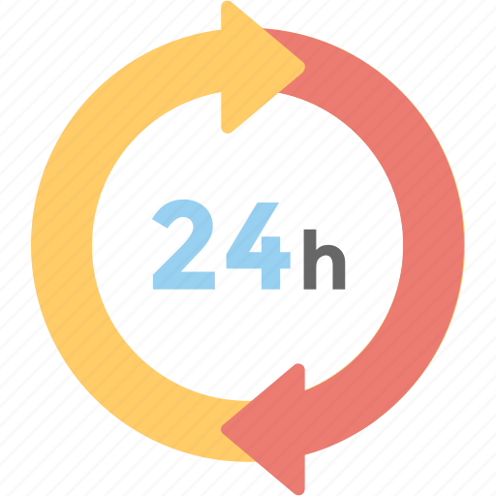
24-HOUR FORECAST
20-10-2022 @ 1200 UTC
Department of Meteorology and Climate Science,
KNUST

Slide 2
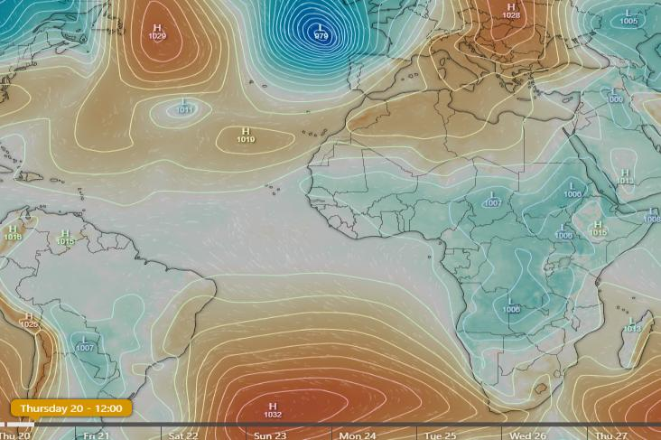
PRESURE SYSTEMS
AT 1200 UTC
1029
1032

Slide 3
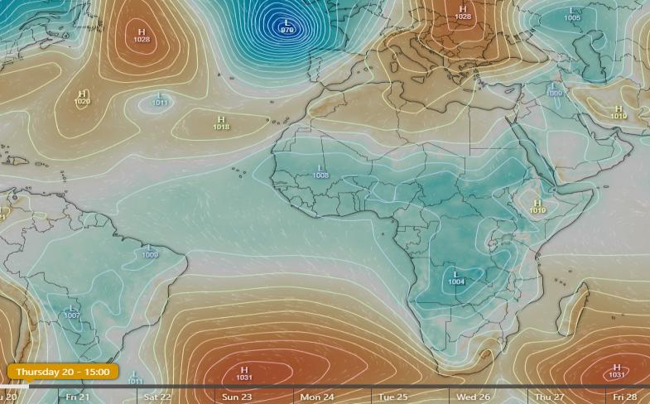
PRESURE SYSTEMS
AT 1500 UTC
1028
1031

Slide 4
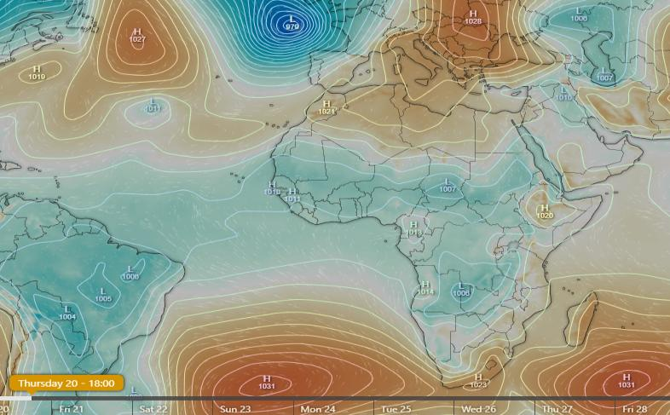
PRESURE SYSTEMS
AT 1800 UTC
1027
1031

Slide 5
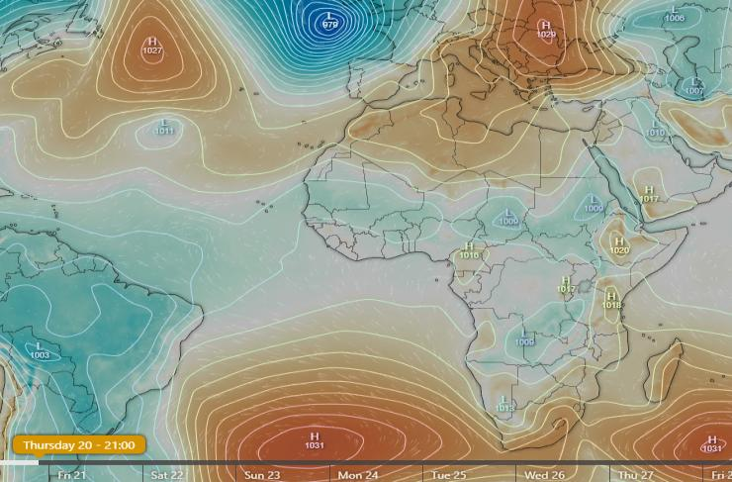
PRESURE SYSTEMS
AT 2100 UTC
1027
1031

Slide 6
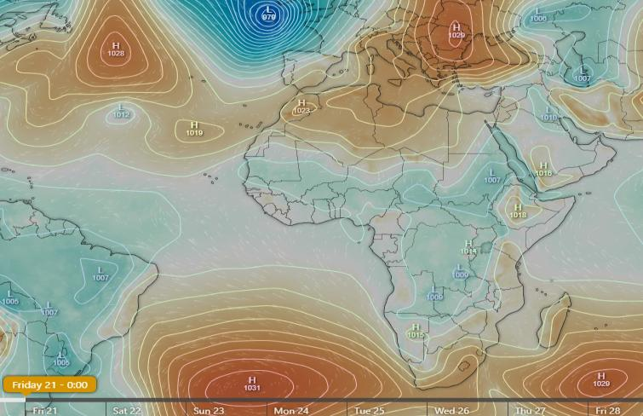
PRESURE SYSTEMS
AT 0000 UTC(FRIDAY)
1028
1031

Slide 7
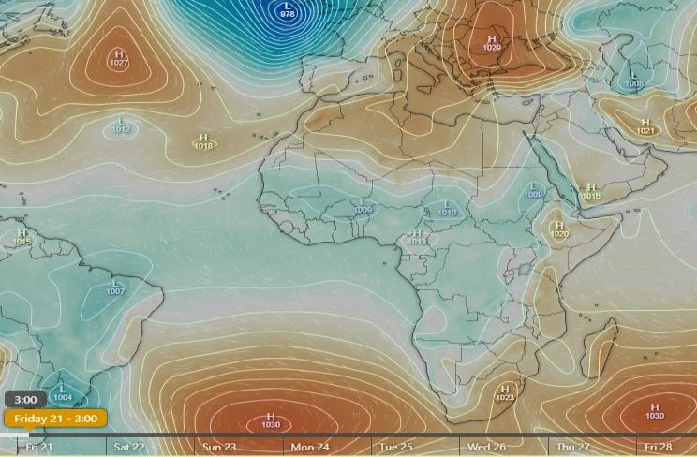
PRESURE SYSTEMS
AT 0300 UTC(FRIDAY)
1027
1030

Slide 8
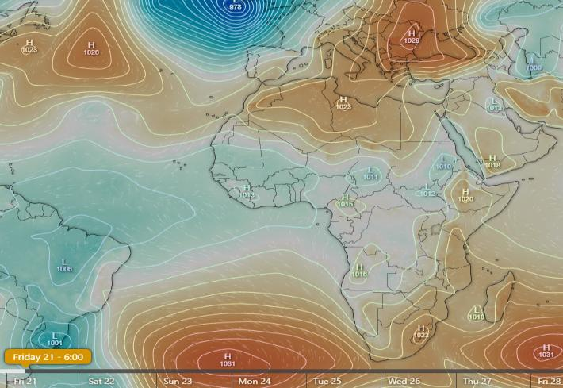
PRESURE SYSTEMS
AT 0600 UTC(FRIDAY)
1026
1031

Slide 9

PRESURE SYSTEMS
AT 0900 UTC(FRIDAY)
1026
1031

Slide 10
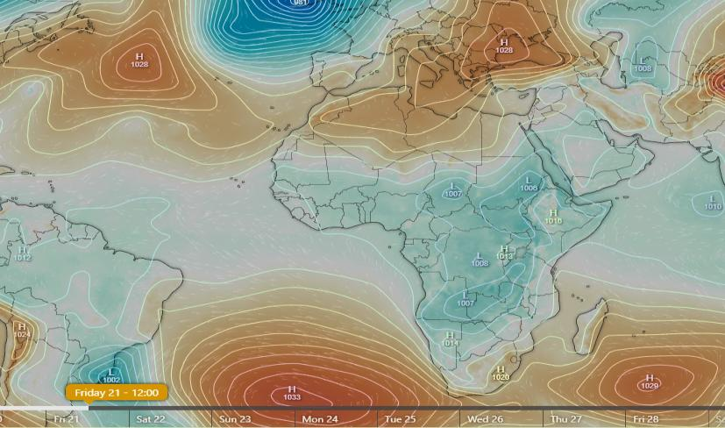
PRESURE SYSTEMS
AT 1200 UTC(FRIDAY)
1028
1033

Slide 11
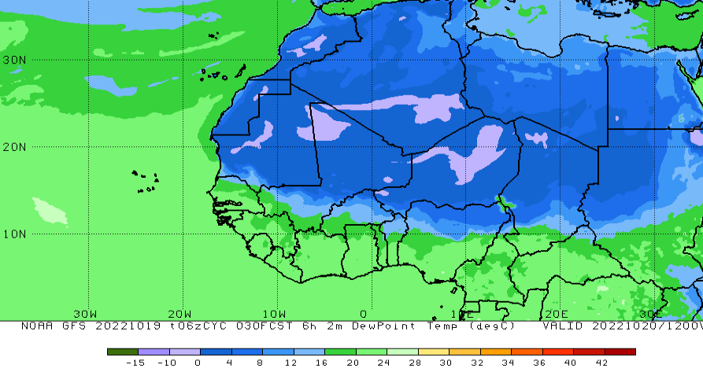
INTERTROPICAL DISCONTINUITY(ITD)
AT 1200 UTC
15.6N

Slide 12
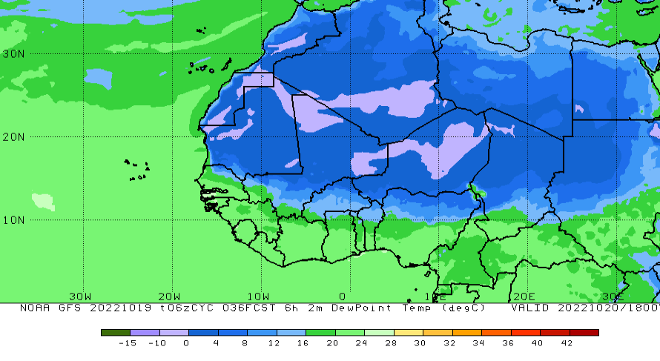
INTERTROPICAL DISCONTINUITY(ITD)
AT 1800 UTC
13.5N

Slide 13
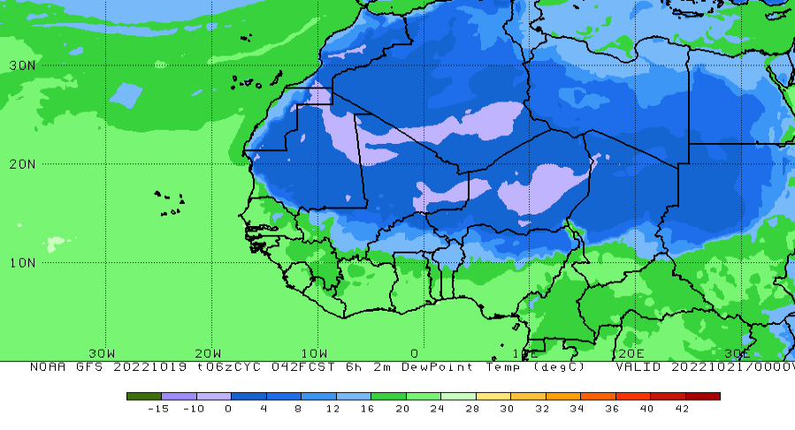
INTERTROPICAL DISCONTINUITY(ITD)
AT 0000 UTC(FRIDAY)
13N

Slide 14
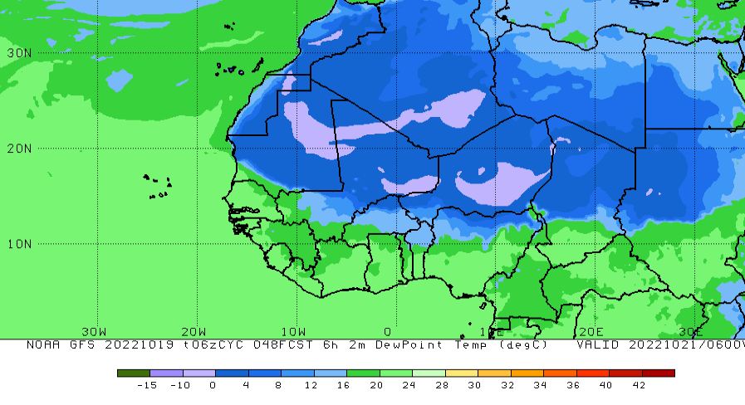
INTERTROPICAL DISCONTINUITY(ITD)
AT 0600 UTC(FRIDAY)
14N

Slide 15
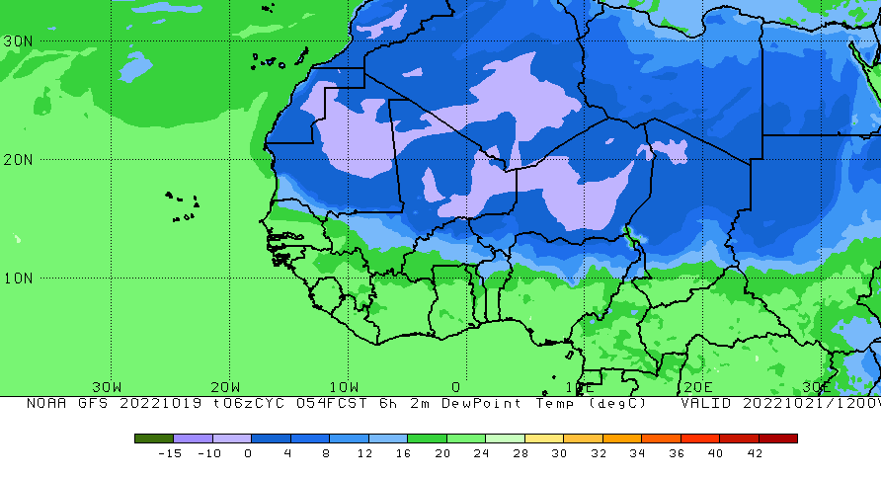
INTERTROPICAL DISCONTINUITY(ITD)
AT 1200 UTC(FRIDAY)
15.1N

Slide 16
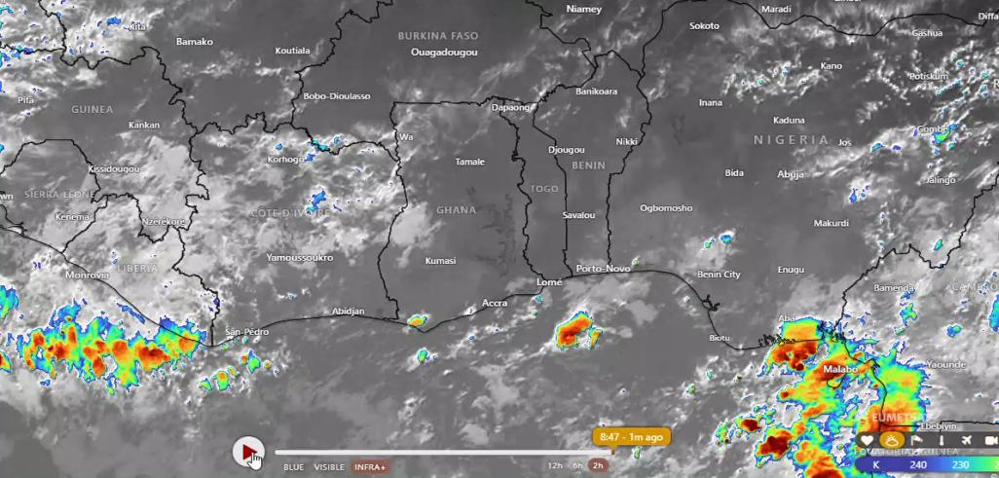
SATELLITE IMAGERY

Slide 17
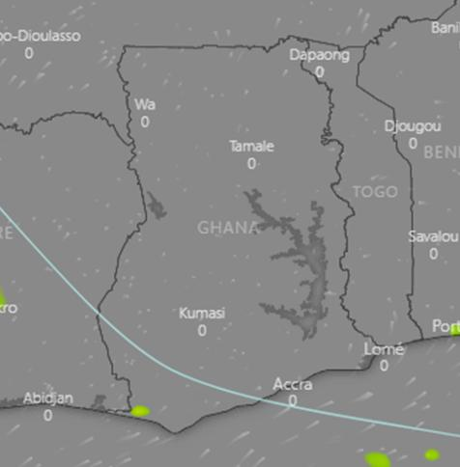
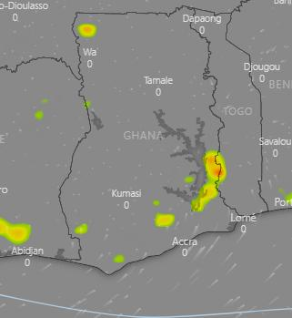
THUNDERSTORM PROJECTIONS
AT 1200 UTC
AT 1500 UTC

Slide 18
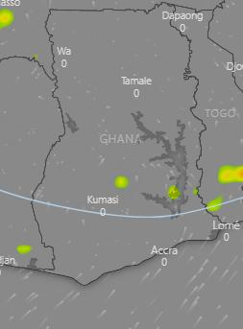
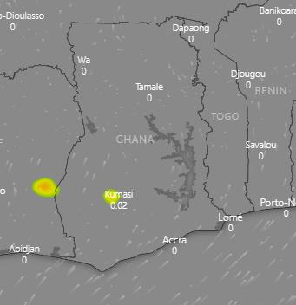
THUNDERSTORM PROJECTIONS
AT 1800 UTC
AT 2100 UTC

Slide 19
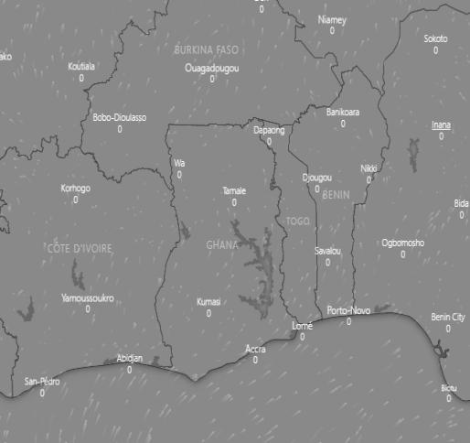
THUNDERSTORM PROJECTIONS
AT 0000 UTC (FRIDAY)
AT 0300 UTC (FRIDAY)

Slide 20
THUNDERSTORM PROJECTIONS
AT 0600 UTC (FRIDAY)
AT 0900 UTC(FRIDAY)

Slide 21
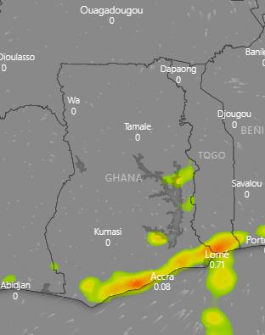
THUNDERSTORM PROJECTIONS
AT 1200 UTC(FRIDAY)

Slide 22
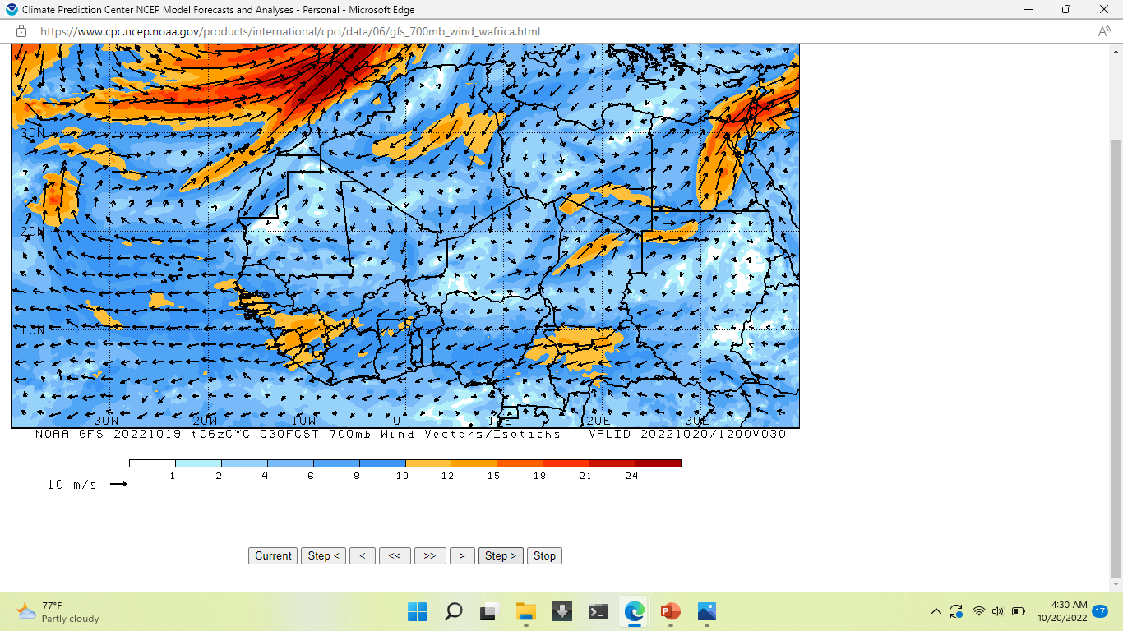
AFRICAN EASTERLY JET
AT 1200 UTC

Slide 23
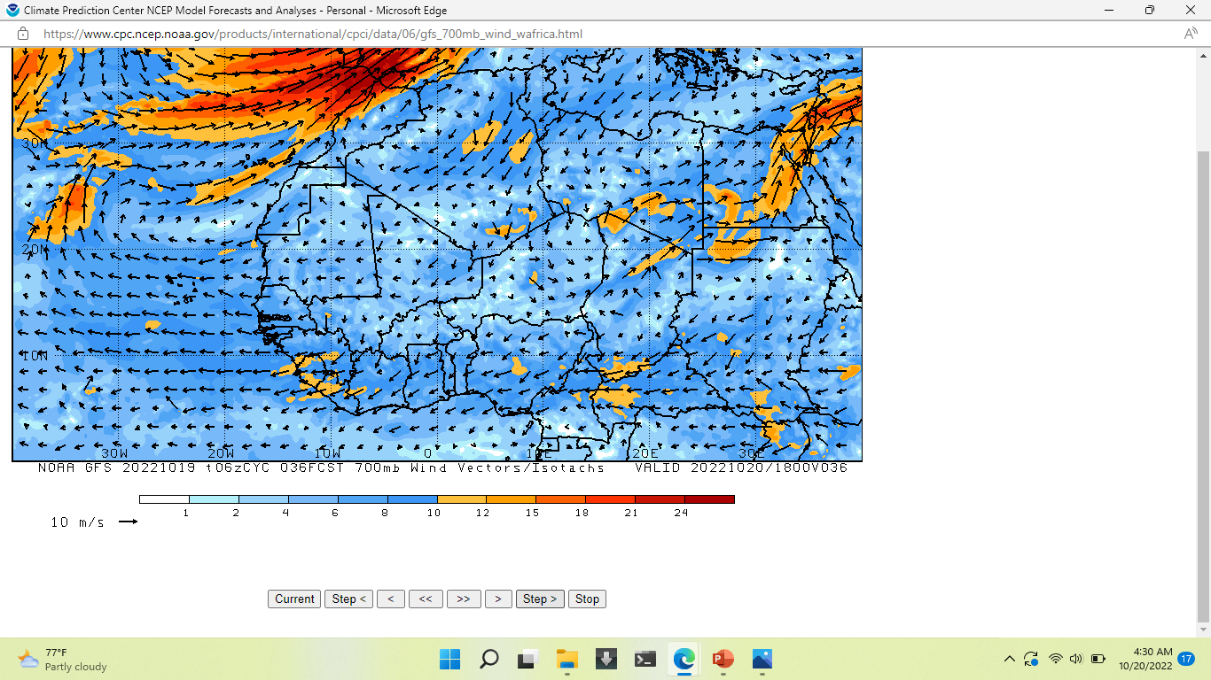
AFRICAN EASTERLY JET
AT 1800 UTC

Slide 24
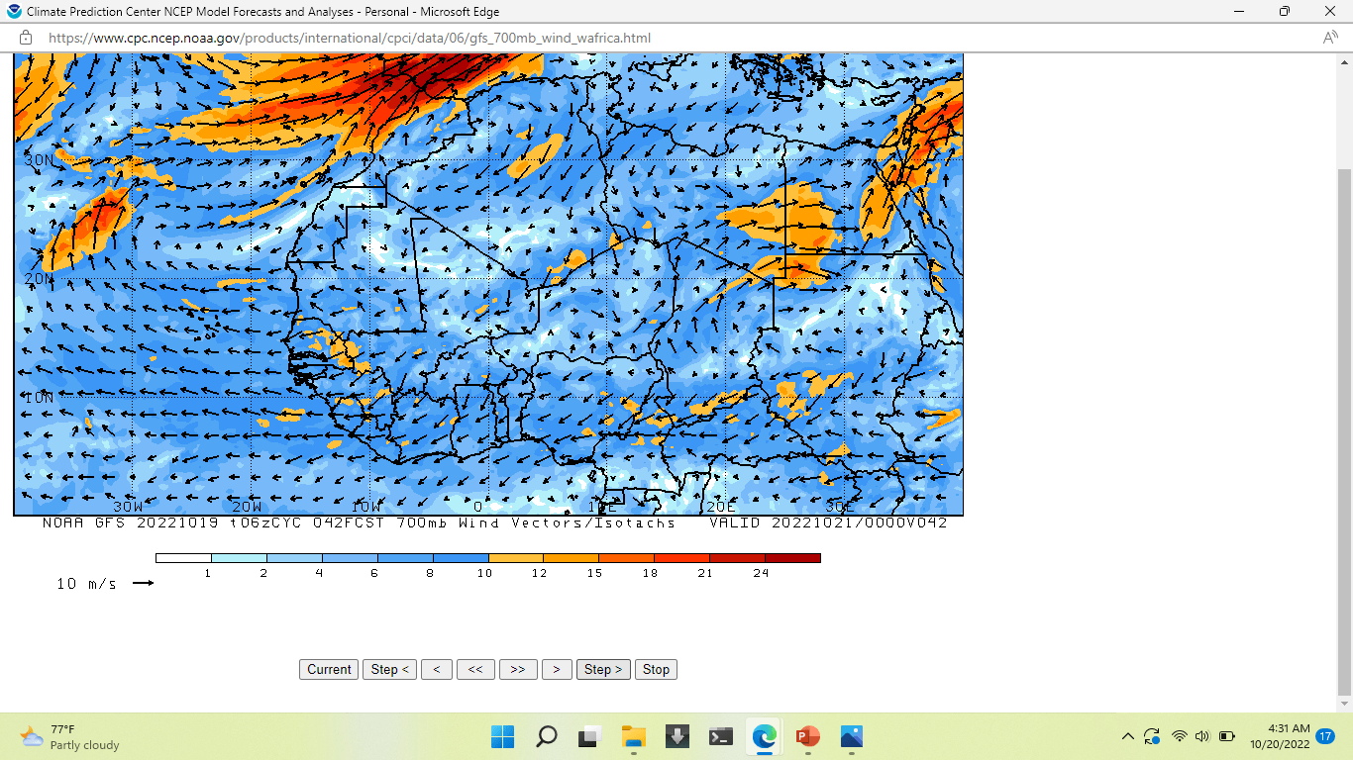
AFRICAN EASTERLY JET
AT 0000 UTC (FRIDAY)

Slide 25
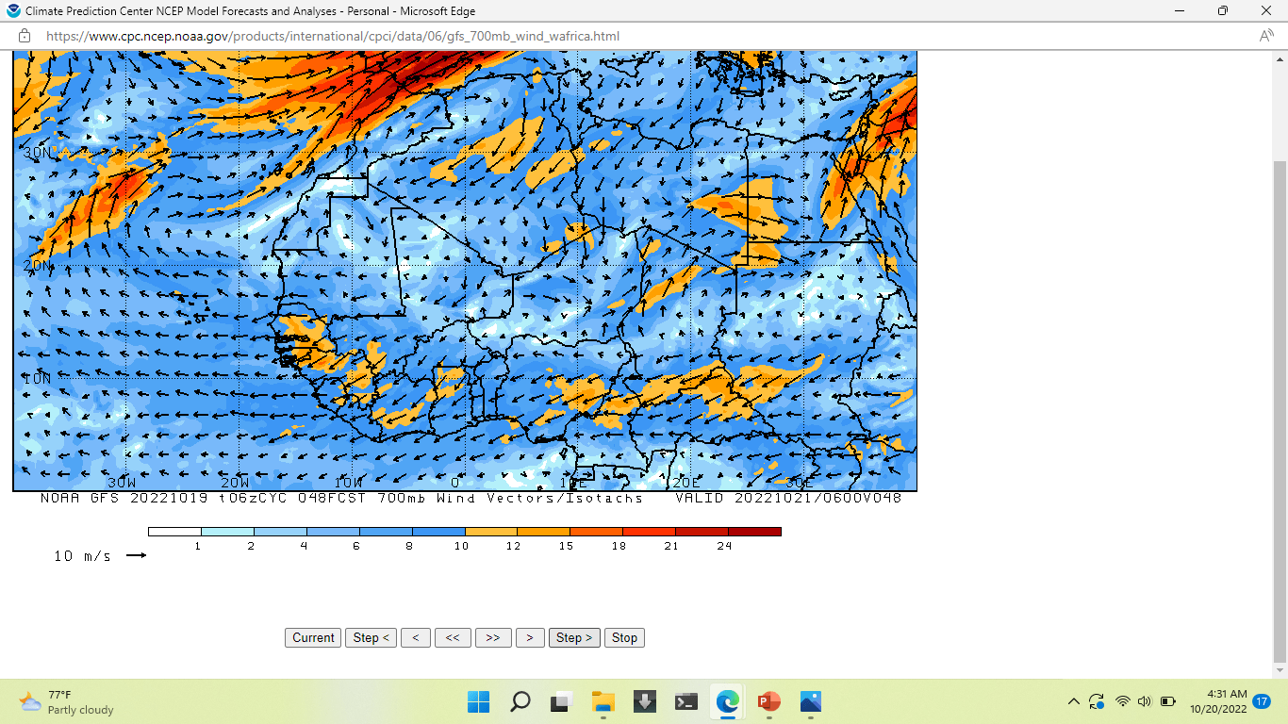
AFRICAN EASTERLY JET
AT 0600 UTC (FRIDAY)

Slide 26
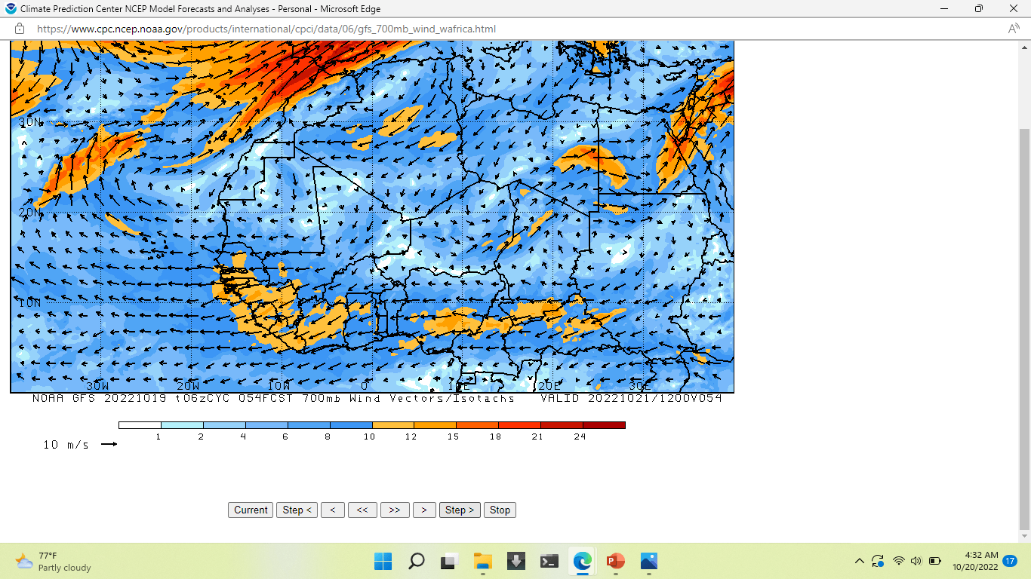
AFRICAN EASTERLY JET
AT 1200 UTC (FRIDAY)

Slide 27
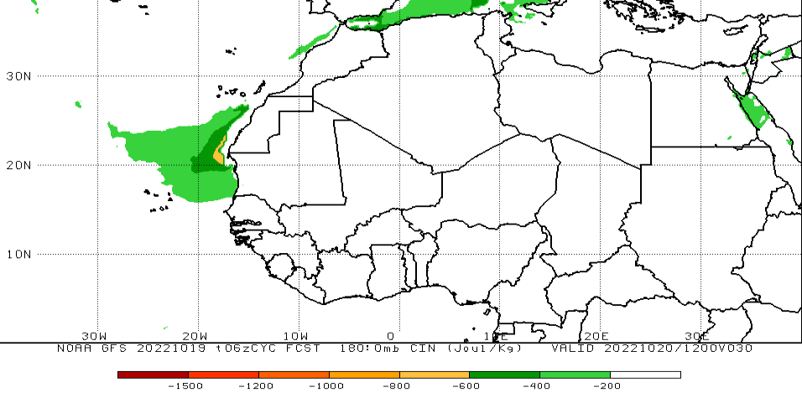
CAPE INHIBITION(CIN)
AT 1200 UTC

Slide 28
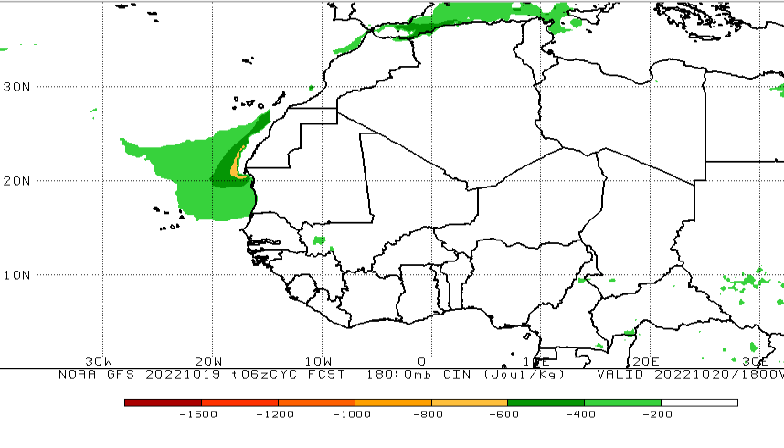
CAPE INHIBITION(CIN)
AT 1800 UTC

Slide 29
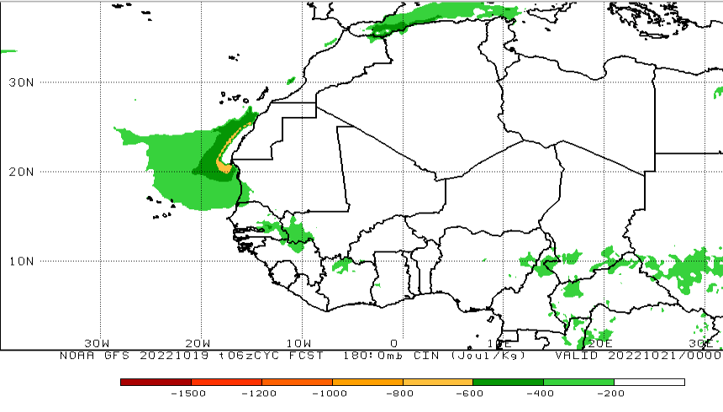
CAPE INHIBITION(CIN)
AT 0000 UTC (FRIDAY)

Slide 30
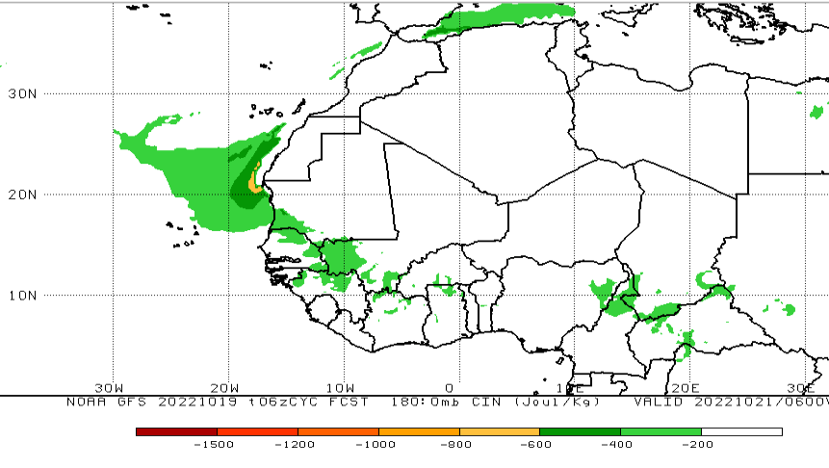
CAPE INHIBITION(CIN)
AT 0600 UTC (FRIDAY)

Slide 31
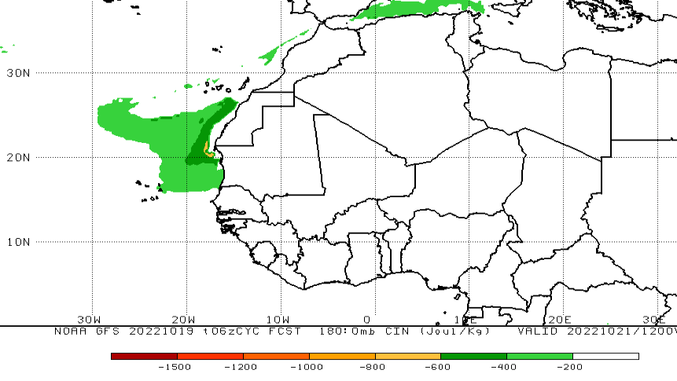
CAPE INHIBITION(CIN)
AT 1200 UTC (FRIDAY)

Slide 32
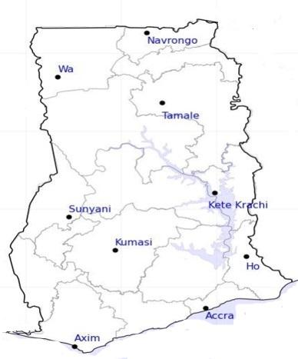
DAY
628.7
CAPE (J/kg)
338.5
NIGHT
976.7
284.3
414.3
284.5
163
269.3
835.3
1621
342.5
1315.7
812
835
278
672.8
584.7
482.3
221.3
253.5

Slide 33

DAY
RH (%)
NIGHT
62
77
67
78
70
81
63
81
73
83
78
92
77
77
97
94
82
88
84
89

Slide 34


DAY
TEMP ($℃$)
NIGHT
32
26
31
26
32
27
33
23
30
25
30
23
31
31
24
23
27
26
26
27

Slide 35

PROBABILITY OF RAINS
30%

Slide 36

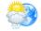


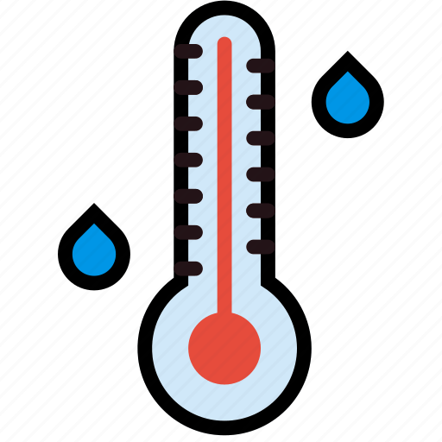




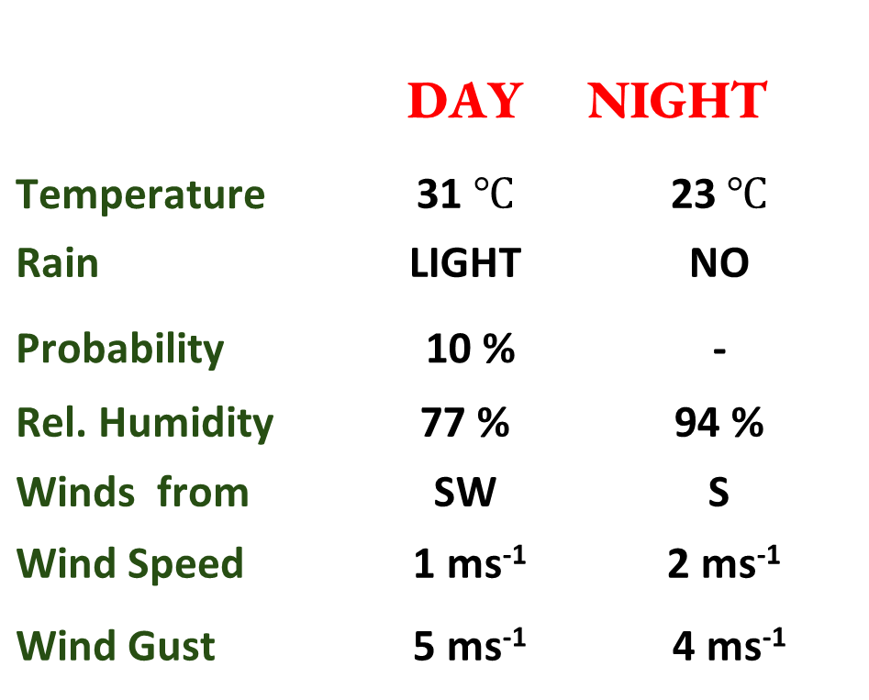
Meteorology and Climate Science
Department of Meteorology, KNUST
24-HOUR FORECAST
20/10/2022 @ 1200 UTC
Rain
Wind
Dust
Forecast Summary (KUMASI)
 | DAY | NIGHT
Temperature | 31 $℃$ | 23$℃$
Rain | LIGHT | NO
Probability | 10 % | -
Rel. Humidity | 77 % | 94 %
Winds from | SW | S
Wind Speed | 1 ms⁻¹ | 2 ms⁻¹
Wind Gust | 5 ms⁻¹ | 4 ms⁻¹
Low risk
Be aware
Be Prepared
Take Action
SUNSET: 05:52 PM SUNRISE: 05:53 AM

